Slide 1
Building Coherence: P.S. 162Q Professional Learning Plan October 5, 2015

Slide 2
Building Coherence: P.S. 162Q Professional Learning Plan October 5, 2015
AGENDA
Referral Process
School CEP and Teacher Data
Professional Learning Plan

Slide 3
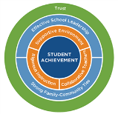
Framework for Great Schools
Student Achievement - “student” in the middle throws cap, 4 people cheer
Rigorous Instruction - running in place with a smile
Supportive Environment - 3 people leaning in to each other
Collaborative Teachers - pointing to all the collaborative teachers
Effective School Leadership - Strike your “Leadership Pose”
Strong Family/Community Ties - “Human Knot”, 4 people interlock hands
Trust - 2 people hold hands and lean back

Slide 4
Highly Effective

Slide 5
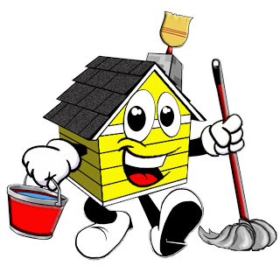
Observations
What it is
A snapshot in time
Daily practice and daily planning
Opportunity to receive feedback to grow practices
What it is not
Your personal best
Repeat lessons

Slide 6
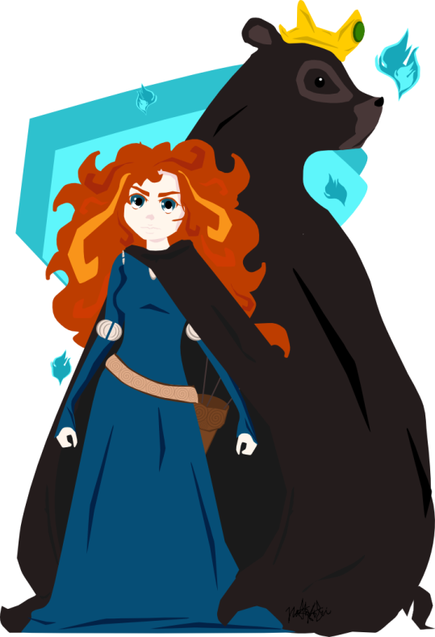
October 2015: Be part of the solution and the learning
Sign up to be visited
Sign up to do learning walks with supervisors

Slide 7
Designing School-Wide Systems for Student Success
Academic Systems
Behavioral Systems
Tier III Interventions
Individual Students
High Intensity
Intensive Individual Interventions
Individual Students
Intense, durable procedures
Wraparound Plans
1-5%
1-5%
5-10%
5-10%
Tier II Interventions
Some students (at-risk)
High efficiency
Rapid response
Group Interventions
Some students (at-risk)
High efficiency
Rapid response
80-90%
80-90%
%
Tier I Interventions
All students
Preventive, proactive
All Academic Areas
Universal Interventions
All settings,all students
Preventive, proactive
School-wide Programming
Notes:
Schools need to address academics AND behaviors, both of which require systems of support. The green triangle represents Universal Design/Response to Intervention which benefits all students: School-Wide. Research shows that usually Tier I Universal Interventions do indeed benefit at least 80-90% of the students within a school. Then there are a few students – about 5-10% who are at-risk and need more and a bit different supports and interventions. Finally, although all students still receive universal interventions, there is a very small 1-5% who will need even more intensive supports. These interventions are still provided within the general education curriculum – this not Special Education, nor does this 1-5% necessarily require a referral to Special Ed at this point.
This is a three tier model. At the first tier, the green triangle, the school would start by ensuring that every student has access to rigorous, grade-level curriculum and highly effective initial teaching. At this tier, teachers are expected to differentiate instruction based on student needs. Teachers must scaffold content, process and product on the basis of student needs. For most students 80-90% benefit from this tier. This tier is both preventive and proactive. It involves all students, all settings.
At tier 2, the school would use on-going formative assessment to identify students in need of additional support usually 5-10% of your population. As well as to target each student’s specific learning needs. At this level, instruction is delivered in small groups using strategies that directly target skills. Progress monitoring is done periodically to assess whether or not the student is responding to the intervention. Hence, response to intervention. At this level, adjustments need to be made to target strategies based on the needs of students. For 5-10% of the population in addition to tier 1, differentiated instruction , students are successful.
There is a small number of students 1-5% who would require intensive support or tier 3 in addition to core instruction. At this level we are monitoring students progress and making adjustments as needed. Notice we have not mentioned a referral to special education. This is all within the general ed context (UDL). Students at this level often have multiple needs intensive help must be individualized based on a problem-solving approach.
Appropriate instruction delivered to all students in the general education class by qualified personnel.
Screenings administered to all students for the purpose of establishing a baseline and identifying those students who are not making academic progress at expected rates.
Instruction matched to student need with increasingly intensive levels of targeted intervention and instruction for students who do not make satisfactory progress in their levels of performance and/or in their rate of learning.
Repeated assessments of student achievement which should include curriculum based measures.
Written notification to the parents regarding the nature and scope of interventions.

Slide 8
Referral Process
Request for evaluation letters (10 days)
PPT-Pupil Personnel Team (monthly meeting)
RTI-Response to Intervention (6-8 weeks)
SIT-School Implementation Team
IEP Teacher

Slide 9
Comprehensive Educational Plan: 5 Goals
By June, 2016, 90% of all students in grades K-5 will improve their comprehension skills as measured by making at least one year’s growth on the TCRWP (Teachers college Reading and Writing project) benchmarks for progress reading levels.
By June, 2016, 100% of teachers will use the language of the P.S. 162 GRRRReat Citizen Program.
By June of 2016, teachers will collaborate horizontally and vertically to align writing curriculum so that 80% of students in grades 3-5 will to maintain or improve one level of student proficiency on written analysis of informational text. utilizing Ready-Gen writing rubric or teacher-created rubrics.
By June, 2016, 75% of teachers will participate in at least one inter- visitation to improve upon their professional goals.
By June, 2016, there will be at least 5 community events offered to parents and families to increase parent participation and there will be at least 30% family participation in at least three of these events as measured by attendance records.

Slide 10
IPC Teacher Goals Data

Slide 11
Instructional Focus
We have examined the following data to determine our instructional focus for 2015-2106:
State exam data
Advance Teacher rating results per component 2014-2015
IPC teacher professional goals
Based on the above data, we will strengthen student accountability and autonomy of learning. We will focus on our questioning and discussion techniques and also planning supports for each subgroup, so that all students can achieve this goal. (3b, 3c, 1e)

Slide 12
“PL” Vision
The vision of our PL Plan for 2015-2016 is to build capacity in instruction while building on our strong culture of collaboration and trust. Our theory of action is a cohesive team of teachers engaged in collaborative learning that will strengthen student learning and achievement.

Slide 13
“PL” Plan
Topics-based training Mondays (~16 sessions)
Teacher team “inquiry/common planning” Mondays (~16 sessions)
Teacher team “inquiry/common planning” Tuesdays (as needed)
(optional) weekly teacher team work during common planning times
Inter-visitations (during school day)
Build in shares and celebrations
PL Evaluations: Staff Development Committee

Slide 14
How are you aligning your PL Plan to the expectations in the QR/PPO rubric?
How will you use your professional learning plan to consistently communicate high expectations to the entire staff and provide training that results in a culture for learning that ensures that all students will be prepared for the next level?
How will you develop teacher pedagogy around a coherent set of beliefs about how students learn best that is informed by the CCLS instructional shifts and the Danielson Framework for Teaching that meets the needs of all learners?
Framework for Great Schools element: Effective School Leadership QR indicator: 1.3, 3.4
Topics-based training Mondays and Chancellor’s Days (~16 sessions)
Whole group, vertically and horizontally-grouped breakout sessions
Team building (4e)
Analyzing Data (1e)
Testing (1a)
Envisions (1a)
Revisiting CCLS (1a)
Positive behavior system (2a, 2d)
Thinking Maps for ELLs (3b)
Student-led discourse (3b)
Explicit teaching versus HOT (3b)
Tiered planning (3c)
Different forms of assessment (3d)
Student goal setting in conferences (3d)

Slide 15
How are you aligning your PL Plan to the expectations in the QR/PPO rubric?
How will teachers engage in structured professional collaborations using an inquiry approach that promotes shared leadership and focuses on improved student learning?
How will I ensure that all students will engage in rigorous, standards-based curriculum in all content areas?
Framework for Great Schools element: Collaborative Teachers, Rigorous Instruction QR indicator: 1.1, 2.2, 4.2
Inter-visitations based on teacher goals (during school day)
Teacher team “inquiry/common planning” Mondays (~16 sessions)
Teacher team “inquiry/common planning” Tuesdays (as needed)
(optional) weekly teacher team work during common planning times
Refine teacher team norms and protocols
Refine coherence of curriculum and ensure points of entry for all students
Refine coherence of literacy and math block components

Slide 16
How are you aligning your PL Plan to the expectations in the QR/PPO rubric?
How do I know what teachers know and don’t know as a result of professional learning? How will you adjust your professional learning plan based on this information? How will you measure professional learning to ensure that it has an impact on teacher practice and student learning?
Framework for Great Schools element: Effective School Leadership, Trust QR indicator: 5.1, 4.1
Build in shares and celebrations for teacher team work
Staff Development Committee meetings (Tuesdays, monthly)
Create and analyze PL evaluations to refine PL structures
Analyze Advance MOTP data

Slide 17
Resources Opportunities
DonorsChoose.org
Project Cicero http://projectcicero.org/teachers/
Other ideas?

